Slide 1
Big Data – Amazon Web Services Week 5
Professor Arturo Castellanos, PhD
Assistant Professor – William & Mary
Big Data - MSBA

Slide 2
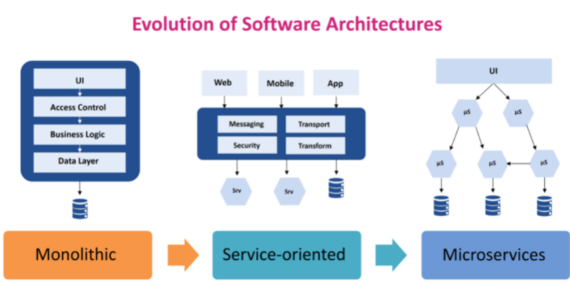
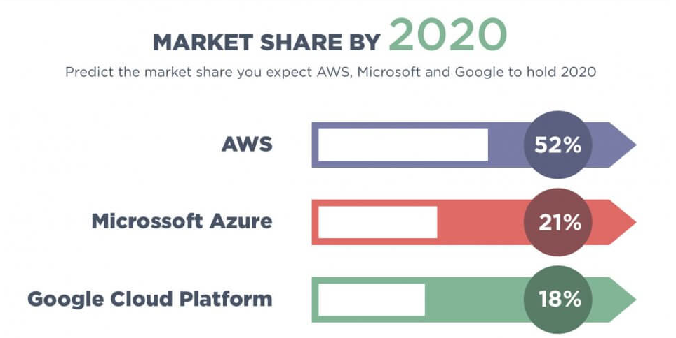

What is a Web Service?
In a Web service a Web technology such as HTTP is used for transferring machine-readable file formats such as XML and JSON.
Source: https://jelvix.com/blog/aws-vs-google-cloud-vs-azure
Source: https://maveric-systems.com/blog/microservices-i-microservices-vs-soa/

Slide 3
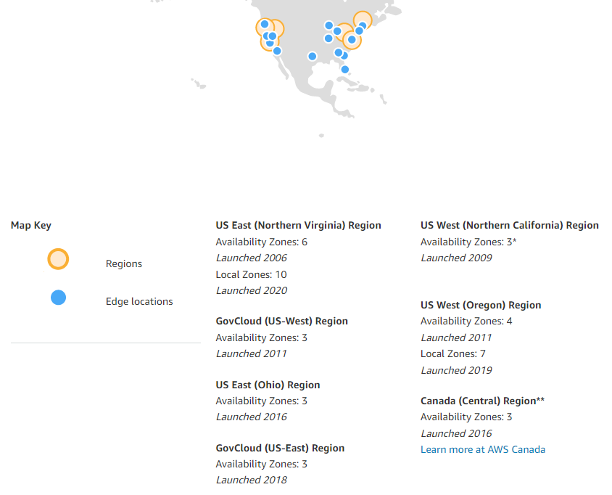
What is AWS Services?
Amazon Web Services (AWS) is a collection of cloud computing services (web services). AWS is located across different regions, with availability zones.

Slide 4
Applications of AWS Services
Amazon Web services are widely used for:
Web site hosting
Application hosting/SaaS hosting
Media Sharing (Image/ Video)
Mobile and Social Applications
Content delivery and Media Distribution
Storage, backup, and disaster recovery
Development and test environments
Academic Computing
Search Engines
Social Networking
Notes:
Source: https://www.guru99.com/what-is-aws.html

Slide 5
Companies using AWS
Instagram
Netflix
Twitch
LinkedIn
Facebook
Snapchat
Pinterest
Dropbox
Notes:
Source: https://www.guru99.com/what-is-aws.html

Slide 6
Availability Zone (AZ)
Provides fault-tolerance
Each region has multiple, isolated locations known as Availability Zones
Low-latency links between AZs in a region <2ms, usually <1ms
When launching an EC2 instance, a customer chooses an AZ
Private AWS fiber links interconnect all major regions
REGION
EC2
AVAILABILITY ZONE 1
EC2
EC2
EC2
AVAILABILITY ZONE 2
AVAILABILITY ZONE 3

Slide 7
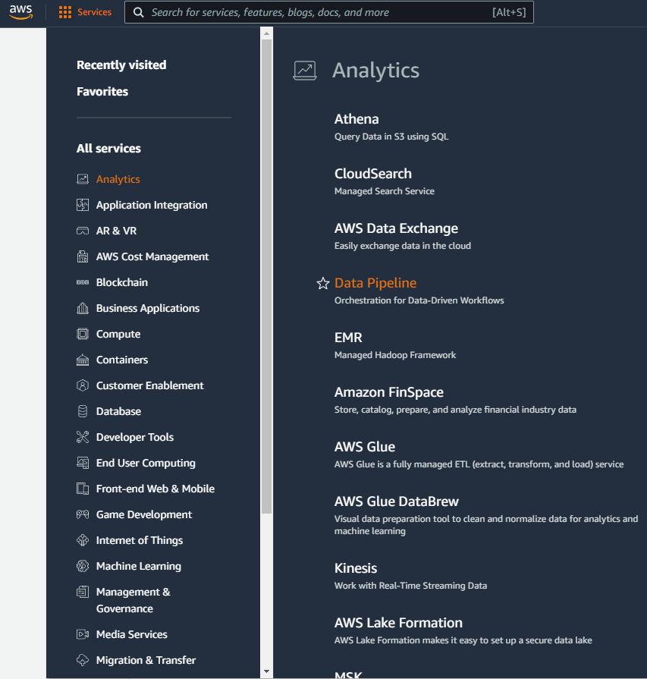
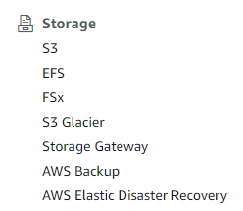
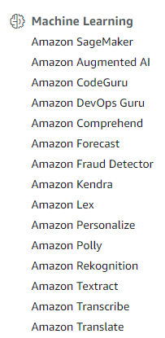
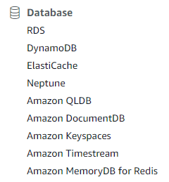

Slide 8
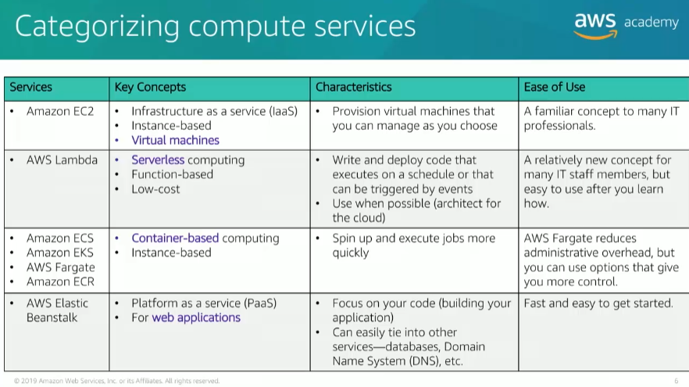

Slide 9
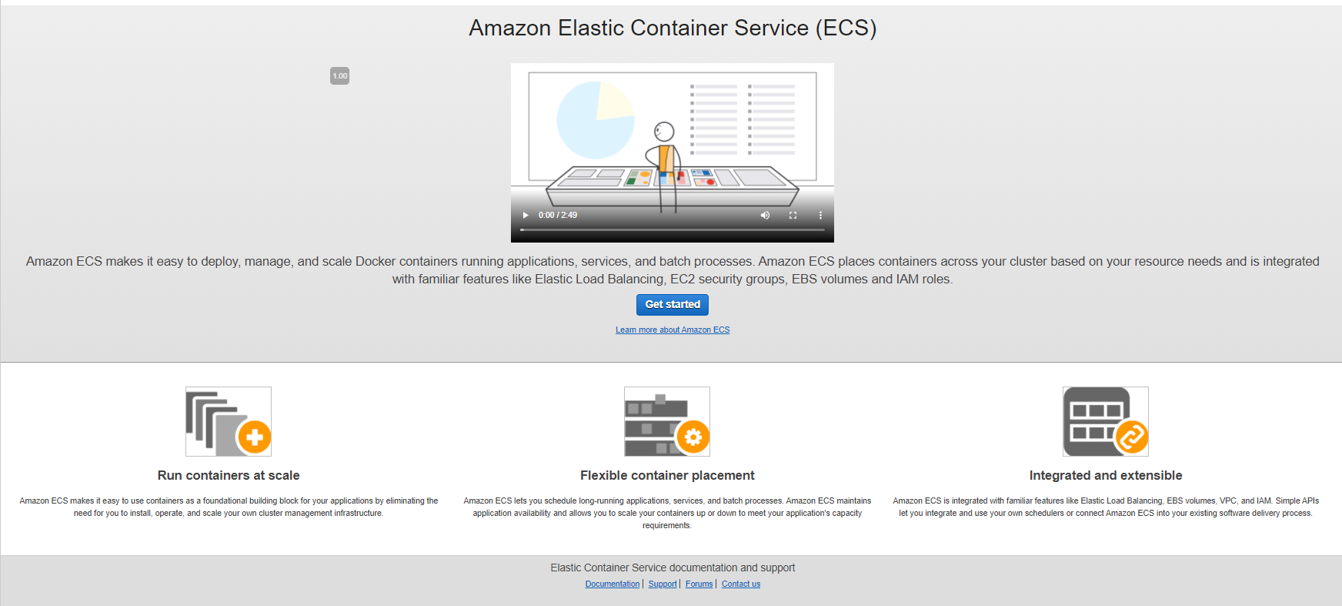

Slide 10
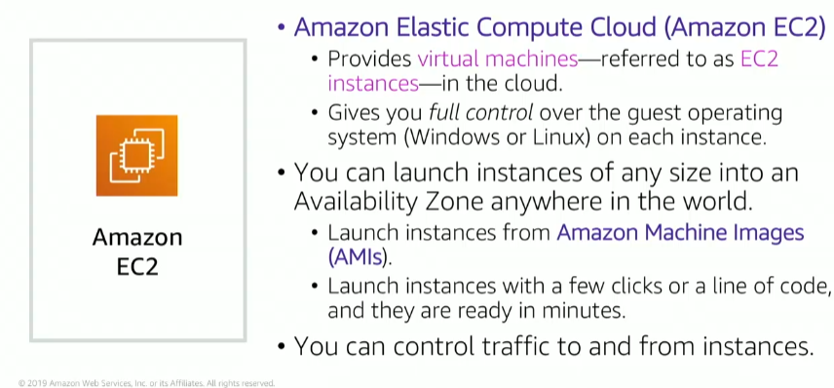
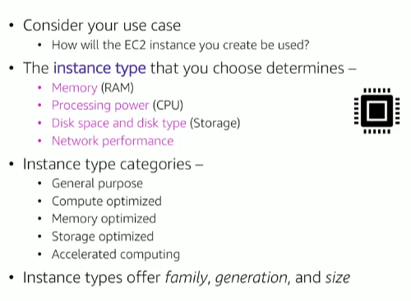
AWS EC2 Instance
Source: AWS Academy – this is covered in ACFv2 - Module 6 - Section 2

Slide 11
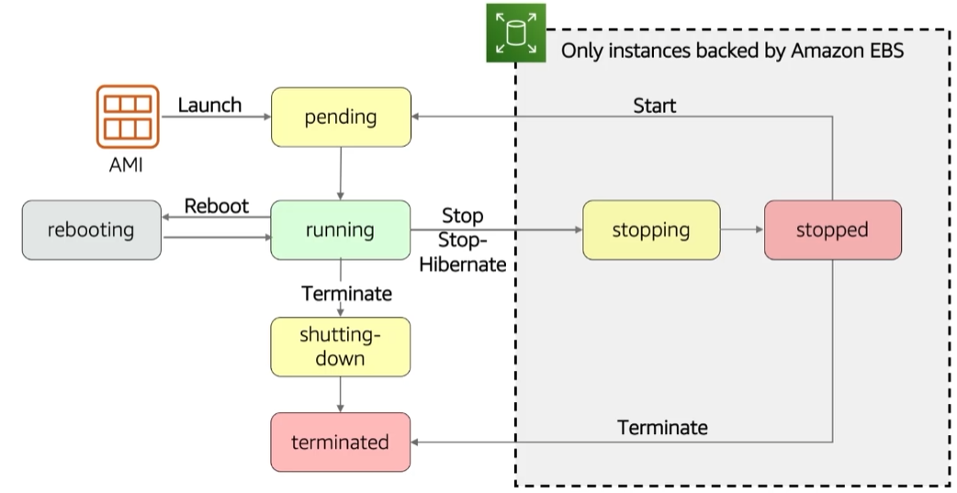
AWS EC2 Instance

Slide 12
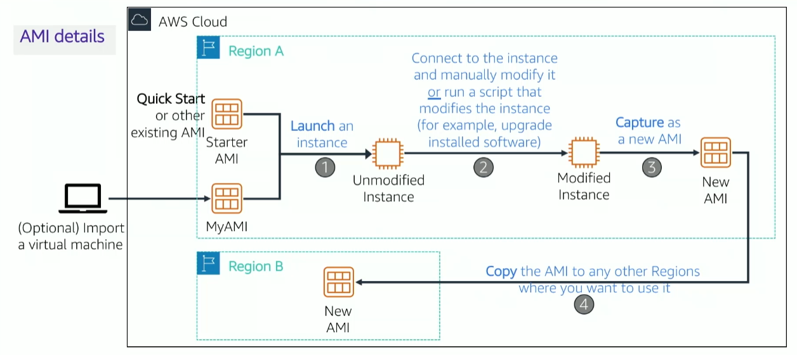
AWS EC2 Instance

Slide 13
3 Ways to Interact with AWS Services
AWS Management Console
Command Line Interface (AWS CLI)
Access to services by discrete commands or scripts
Software Development Kits (SDKs)
Access services directly from your code (e.g., Java, Python, others)

Slide 14
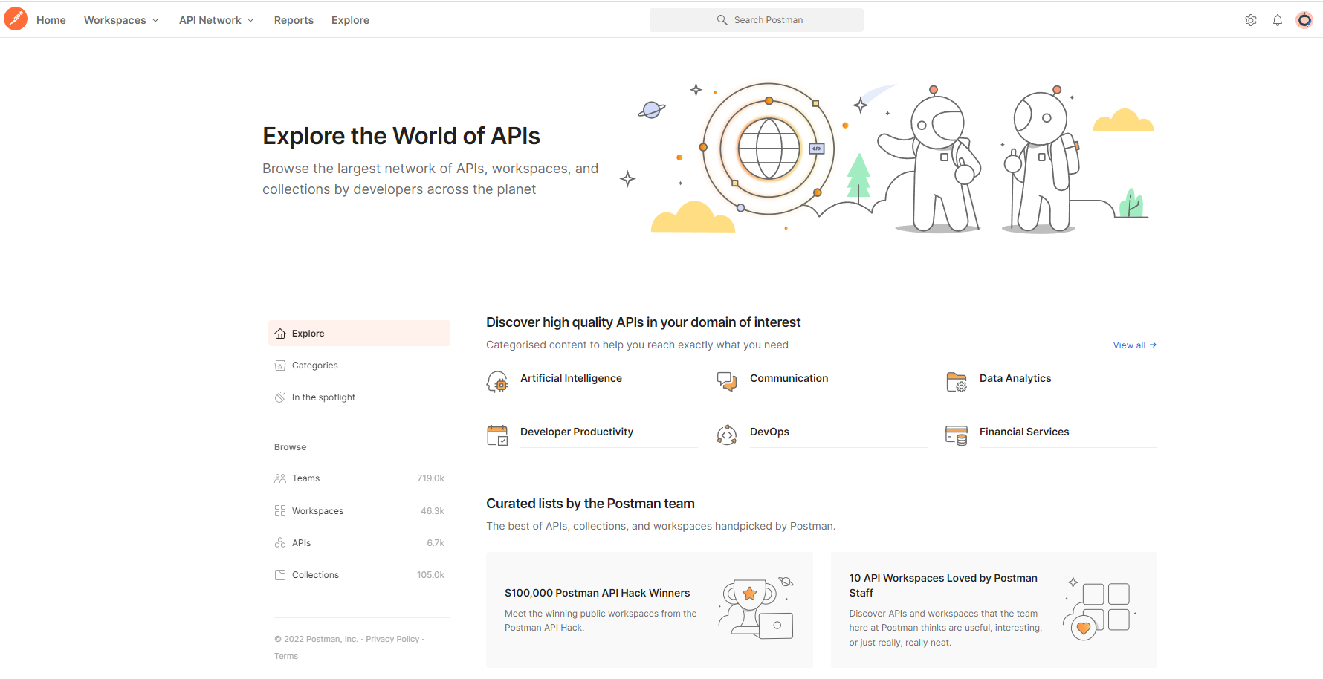

Slide 15
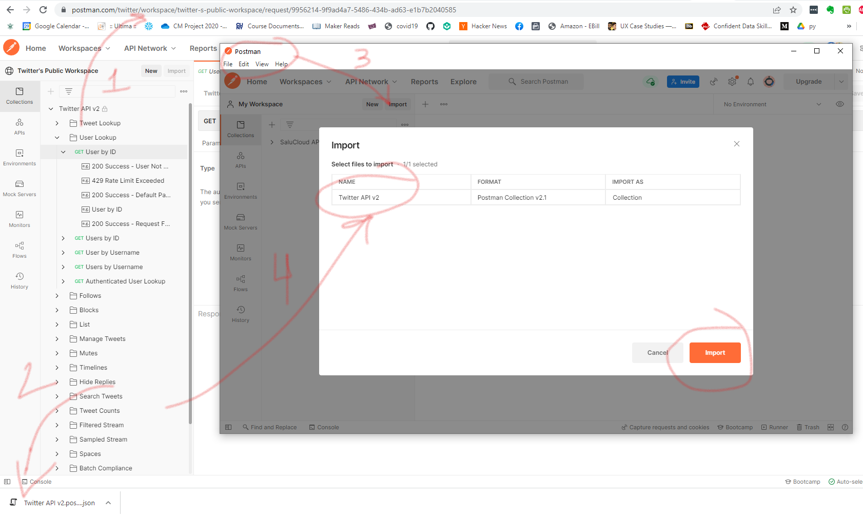

Slide 16
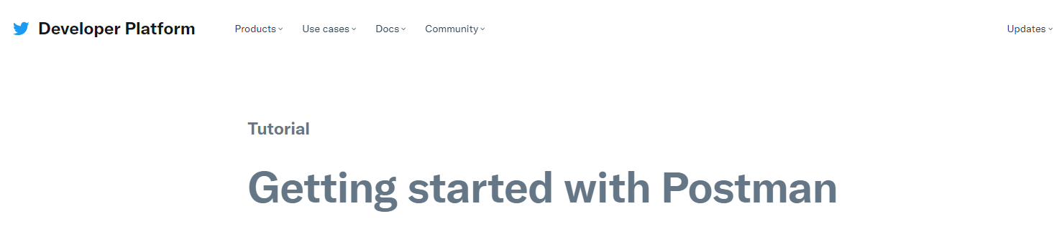
https://developer.twitter.com/en/docs/tutorials/postman-getting-started
Before next class: Request your AWS credentials (developer.twitter.com) and run the Jupyter notebook I provided with your credentials.

